Slide 1

I can LTE even… [MVP]
How I service providered and you can too!

Slide 2
Relevant Background Information
I’ve done some 4G/5G things
LTE and It’s Collective Insecurity – Wall of Sheep – DC24
SPARROW – bouncing messages across towers – DC 29
Site surveys/Port Scanning of devices
I have a strong burning desire to be my own terrible service provider
Done some (minor) hacking with srsRAN
I love weird, strange, esoteric, unloved protocols and systems

Slide 3
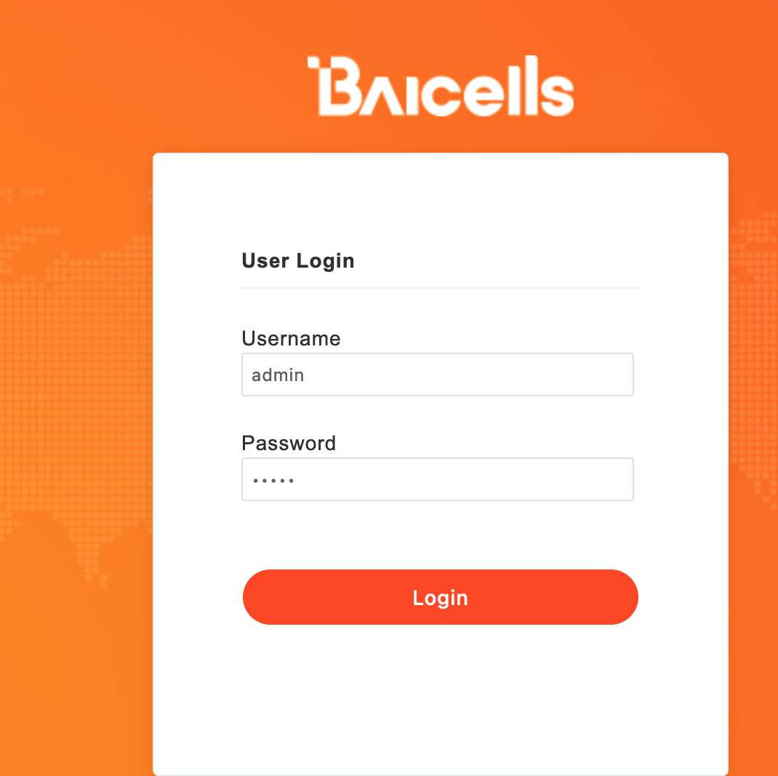
The story so far
While researching 5G stuff, decided to scan the Internet for hosts that ”speak” 4G/5G. SCTP + GTP, that sort of stuff. See previous presentations.
https://github.com/nobletrout/sctpscan
Ran into a lot expensive stuff (Ericsson), but also ran into a lot of stuff that looked like this
Web management ports on an “MME” isn’t normally a thing

Slide 4
What the heck… Some furious googling later and found out the following
There is an entire sub-industry selling low buck 4G equipment
There is a band set aside for regular folks like you and me (CBRS)
You need to be certified and pay the man $600
For about $2000 equipment costs you can run your own 4G network out of your house
Legally
Data only (well not really true but true enough)
SIM Cards, management consoles, all of that

Slide 5
complejidad, ¡adiós! Remedial LTE discussion
COMPLICATED
MANY MUCH ACRONYM
NOT FUN
PUT TO SLEEP
HOW MAKE NOT SO BORING?
WORDS WORDS WORDS

Slide 6
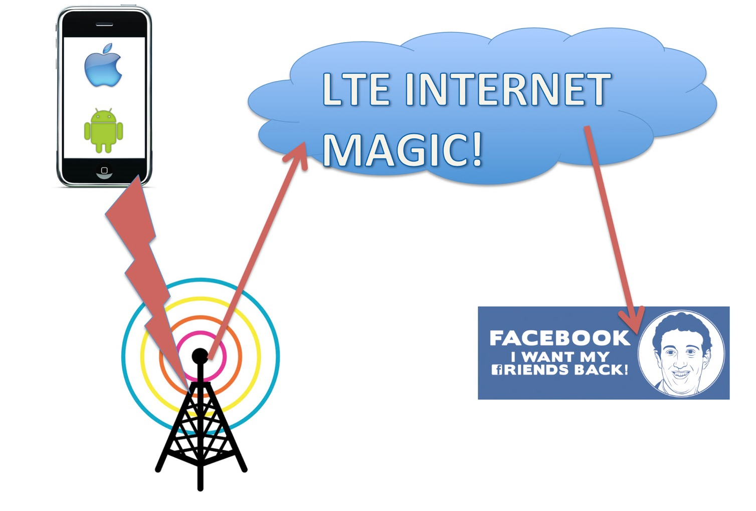



Desired End State
Sure I guess I need SIM Card?
Just give me web management thing
Just connect me to internet

Slide 7
CBRS Tiers
CBRS is broken into three parts
We are interested in the last tier. Everything for setting up your own LTE network is about avoiding interfering with everyone else.
Tier 1
Tier 2
Tier 3
Incumbents
Preferred Access Lines (PAL)
The rest of us
Service Providers
Gubberment
me
you

Slide 8
Spectrum Considerations - CBRS
CBRS is not wild west
You must be a Certified Product Installer (CPI)
You must take a training class
You must get the certificate (yes crypto digital one, that kind, real kind)
Then you can get spectrum “assigned” to your enodeB, I mean CBSD, no cell tower
Device (tower) needs spectrum assigned to it
To get access to a SAS you must be a CPI
To become a CPI you must take a $600 class and get digital certificate
Spectrum is granted by Spectrum Access System (SAS)

Slide 9
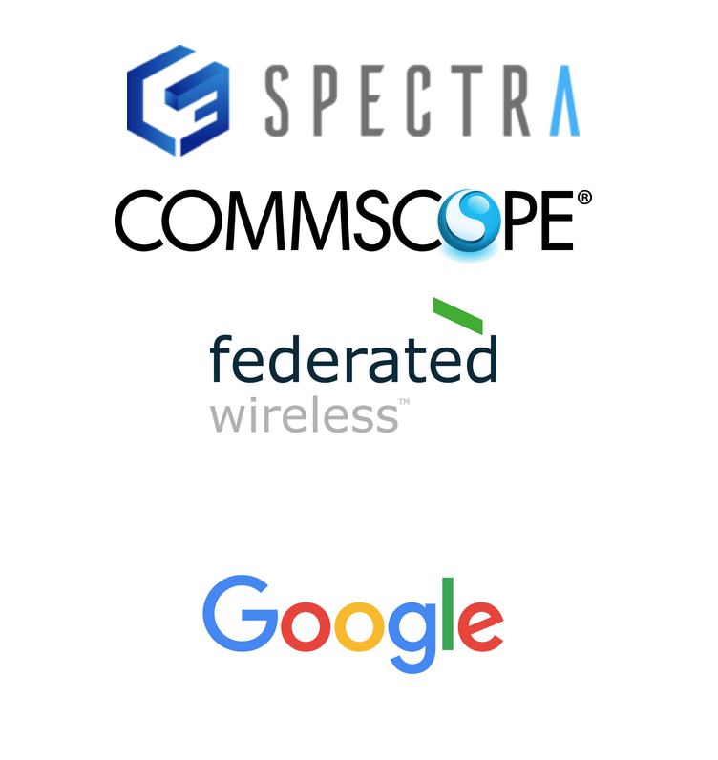
First hurdle, how do I get certified?
Start with the WinnForum CBRS standards
https://cbrs.wirelessinnovation.org/cpi-training-program
Bottom line, one of these vendors on right
I went with google because no human contact needed
Training takes about 6 hours
You get digital certificate in a day or so
The training will tell you all sorts of boring stuff, like azimuths, above ground level measuring, etc

Slide 10
Great I got my certificate but I don’t have any gear. What gear should I get?
You need at least an eNodeB (cell tower) and a UE (phone)
I went with a baicell Nova430i (i – internal antenna) for eNodeB
I got one of their CPE (customer premise equipment) for the UE (”handset” but in this case a bridge). Six of them actually.
https://ongoalliance.org/certification/fcc-authorized-end-user/
Anything here should work, including later model ipads, iphones, pixels, etc
Make sure it’s unlocked!
I bought through a reseller “Double Radius”, but there are many other resellers and whatnot for this stuff
SIM Cards – Maybe not needed, but start with a few of them

Slide 11
Infrastructure! – User other people’s computers
Most of the complexity of LTE/5G is the ”packet core”, a scary, horrible place full of acronym soup designed by telephone companies to be for telephone companies.
Don’t let them win. Baicell, and I’m sure others, now provide a full “packet core” that leaves you with just a management console in the cloud to handle SIM card registration, tower management, CPE equipment management. It isn’t the best, but it isn’t weird and strange.
For privilege of having this complexity removed for you, Baicell will charge you $1/UE per month.

Slide 12
Infrastructure – Part Two - SAS
Spectrum assignment needs to be managed by a SAS. Part of the reality of getting access to the CBRS means that you need to enslave your tower to the will behemoths like Google, that will assign what spectrum and power parameters your tower can use.
Google’s SAS service costs about $2 per device per month.

Slide 13
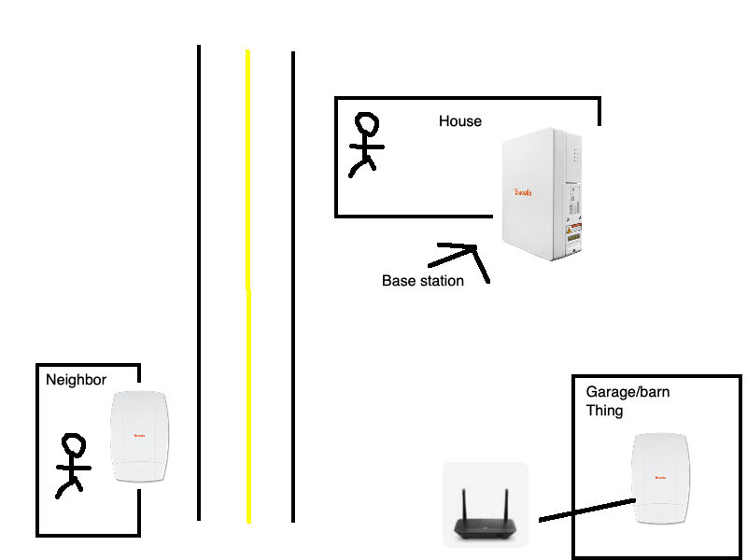
DEMO TIME!

Slide 14
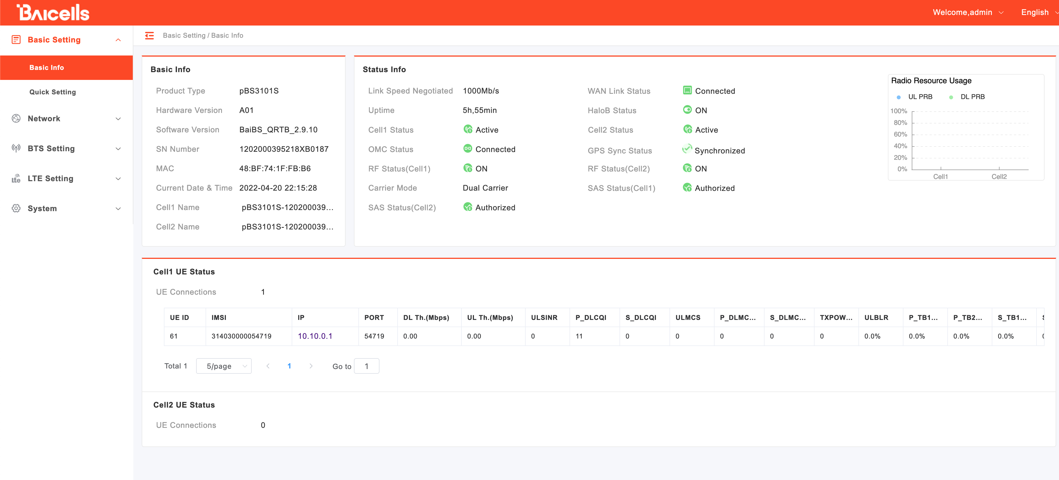

Slide 15
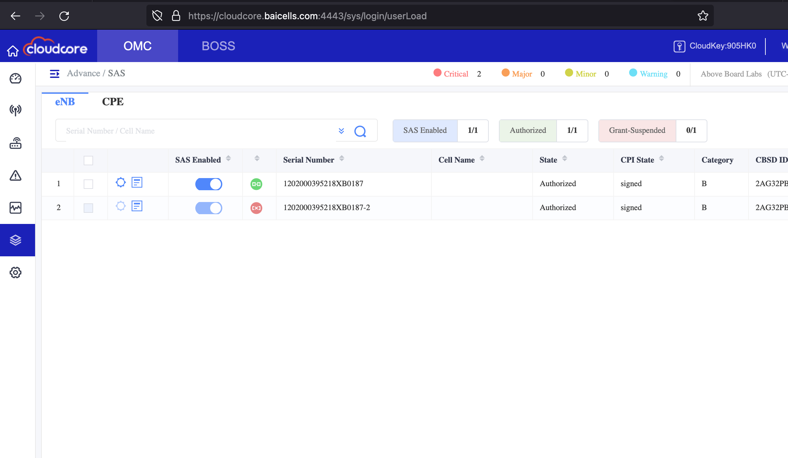

Slide 16
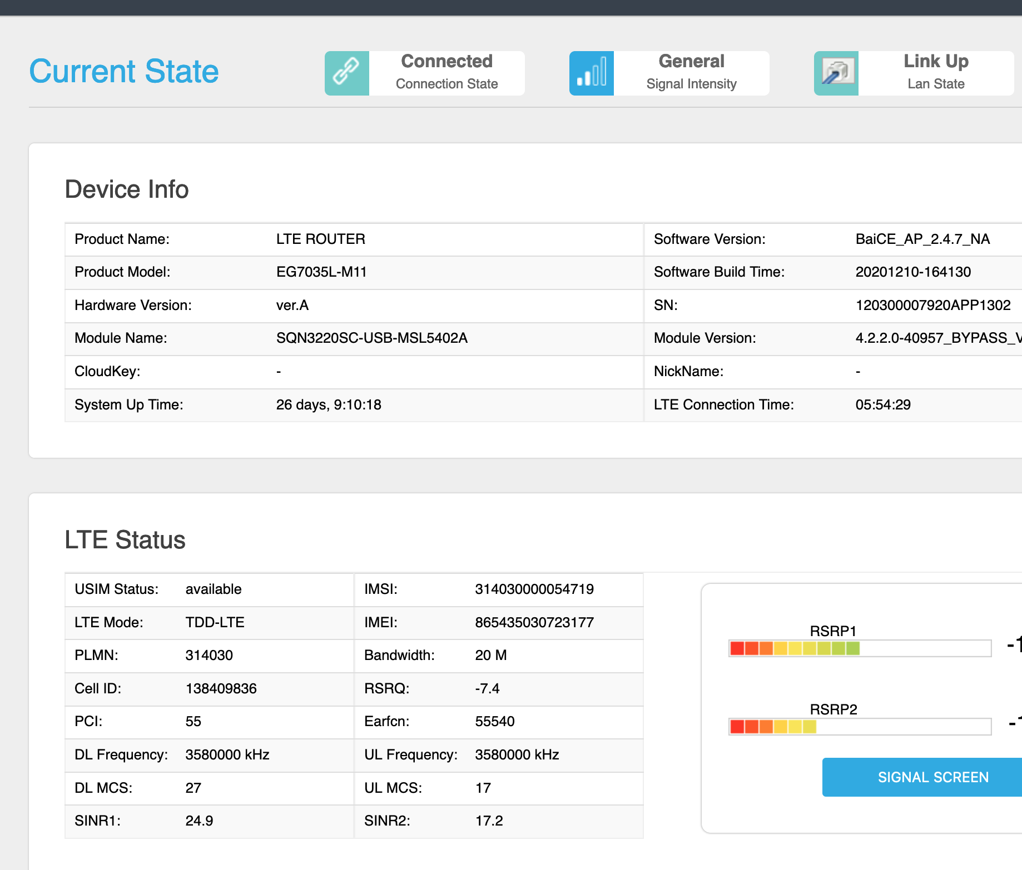

Slide 17
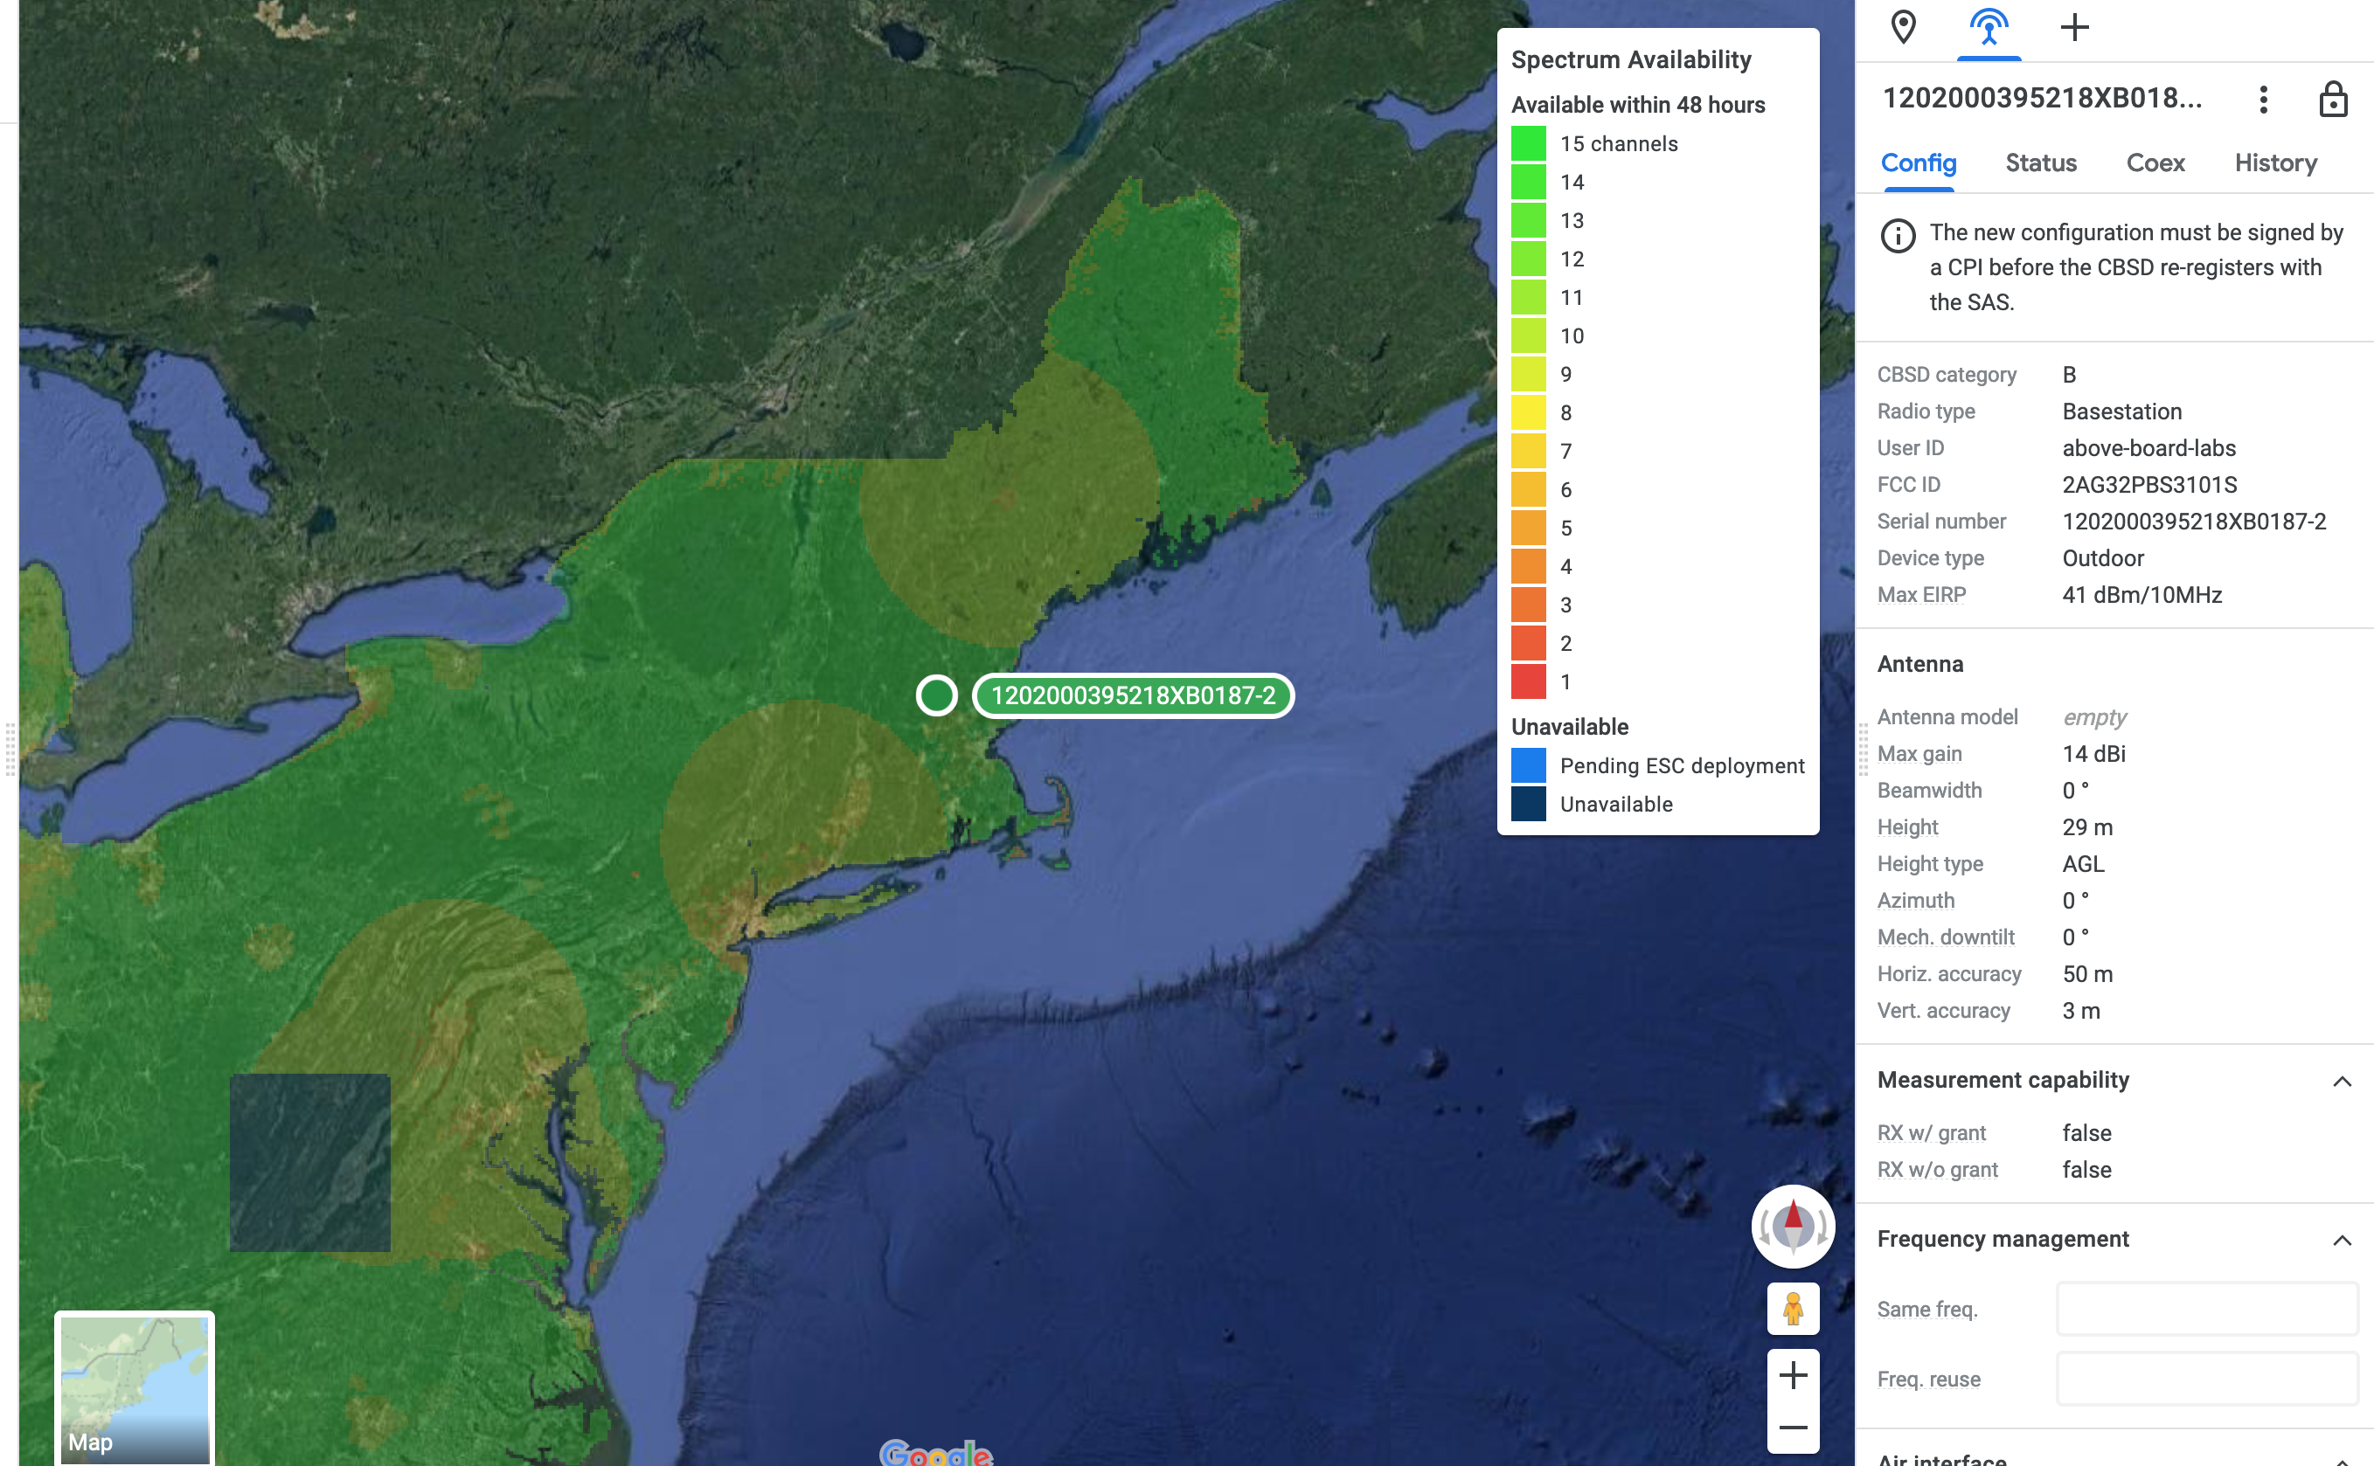

Slide 18
Next
Quantifiable speed and distance
Get an iphone/ipad/pixel and test the distance on this sucker. How far into the woods can I go?
I engaged our local high school initially thinking this might make a good way of extending range for wifi.
Gotten stalled along the way
Looking to help people get cheap access to high(er) speed broadband in locations that are expensive and bad access

Slide 19
TL;DR
Get a Certified Product Installer training and certificate for $600
Buy your CBRS LTE Gear from someone like Baicell
Register your devices with a SAS Provider (like Google)
Register your devices with a cloud managed packet core
Activate SIM card
Have LTE network

Slide 20
Thanks to
The Hacker Initiative (https://hackerinitiative.org/)
Boston Security Meetup
Resources
https://www.google.com/get/spectrumdatabase/sas/
https://www.coursera.org/learn/google-cbrs-cpi-training
https://blinqnetworks.com
https://na.baicells.com/

